Slide 1

Skip Lists
Prepared by Shmuel Wimer
Courtesy of Prof. Dror Rawitz

Slide 2






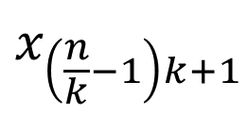
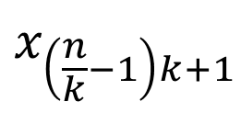
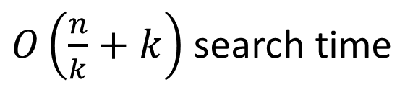





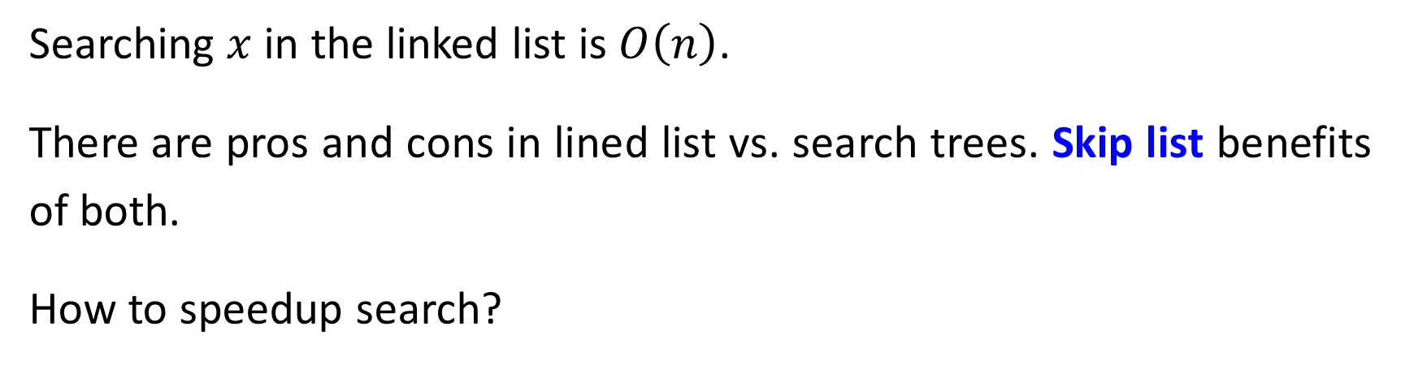



Searching $x$ in the linked list is $O\left(n\right)$.
There are pros and cons in lined list vs. search trees. Skip list benefits of both.
How to speedup search?
$O\left(\frac{n}{k}+k\right)$ search time
$$x_{\left(\frac{n}{k}−1\right)k+1}$$
$$x_{1}$$
$$x_{k+1}$$
$$x_{n}$$
$$⋯$$
$$⋯$$
$$⋯$$
$$⋯$$
$$x_{k−1}$$
$$x_{k}$$
$$x_{\left(\frac{n}{k}−1\right)k+1}$$
$$x_{n−1}$$
$$x_{n}$$
$$x_{1}$$
$$x_{2}$$
$$x_{k+1}$$

Slide 3

































$$L_{5}$$
$$−∞$$
$$+∞$$
Search reduced to $O\left(\log{n}\right)$, memory is doubled.
$$L_{4}$$
$$−∞$$
$$21$$
$$+∞$$
$$L_{3}$$
$$−∞$$
$$+∞$$
$$9$$
$$21$$
$$L_{2}$$
$$−∞$$
$$6$$
$$9$$
$$17$$
$$21$$
$$26$$
$$+∞$$
$$L_{1}$$
$$−∞$$
$$3$$
$$6$$
$$7$$
$$9$$
$$12$$
$$17$$
$$19$$
$$21$$
$$25$$
$$26$$
$$+∞$$

Slide 4
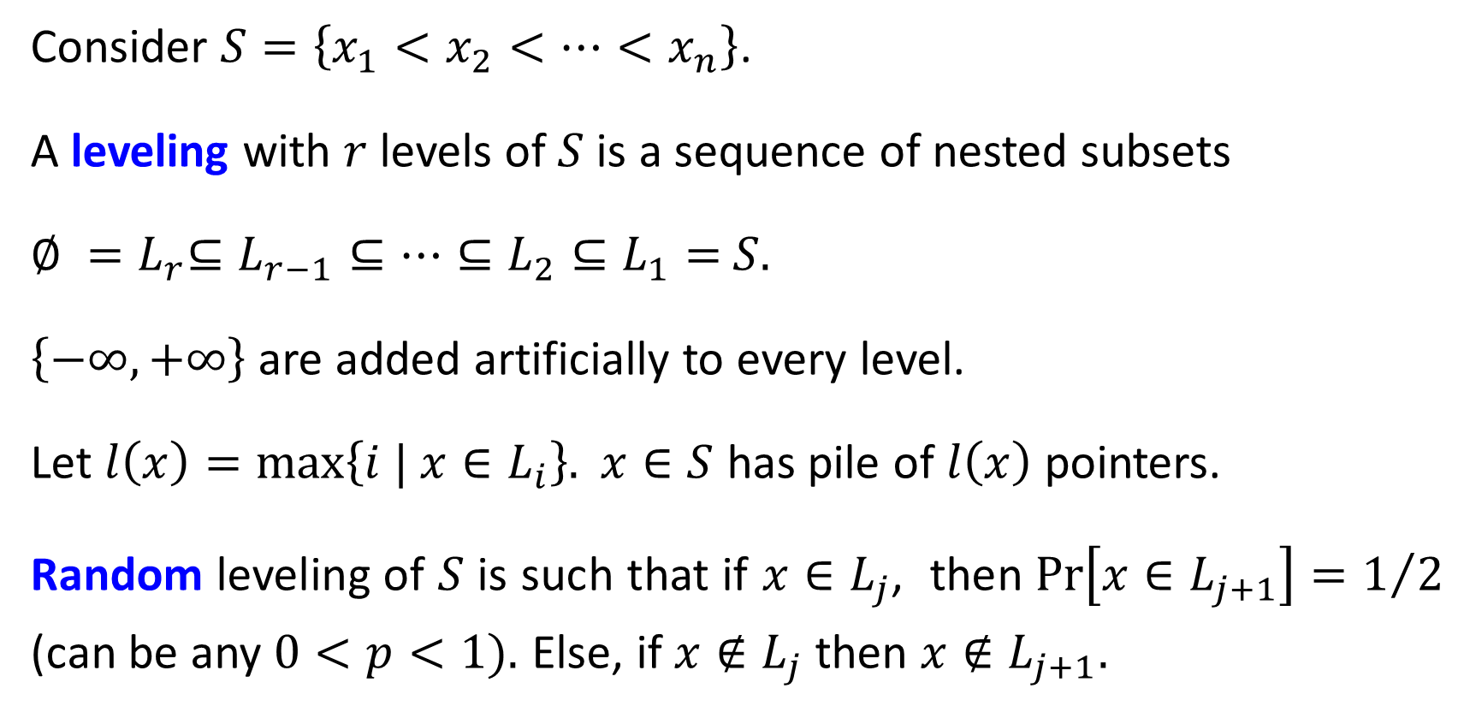
Consider $S=\left\{x_{1}<x_{2}<⋯<x_{n}\right\}$.
A leveling with $r$levels of $S$ is a sequence of nested subsets
$∅ {=L}_{r}⊆L_{r−1}⊆⋯⊆L_{2}⊆L_{1}=$ $S$.
$\left\{−∞, +∞\right\}$ are added artificially to every level.
Let $l\left(x\right)=\text{max}\left\{i | x∈L_{i}\right\}.$ $x∈S$ has pile of $l\left(x\right)$ pointers.
Random leveling of $S$ is such that if $x∈L_{j}$, then $Pr\left[x∈L_{j+1}\right]=1/2$ (can be any $0<p<1$). Else, if $x∉L_{j}$ then $x∉L_{j+1}$.

Slide 5




























































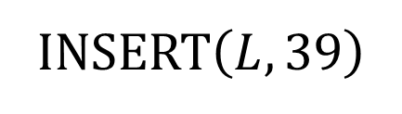









INSERT$\left(L,39\right)$
$$L_{4}$$
$$−∞$$
$$50$$
$$50$$
$$+∞$$
$$+∞$$
$$−∞$$
$$12$$
$$12$$
$$L_{3}$$
$$−∞$$
$$12$$
$$−∞$$
$$12$$
$$31$$
$$39$$
$$50$$
$$50$$
$$+∞$$
$$+∞$$
$$31$$
$$L_{2}$$
$$−∞$$
$$−∞$$
$$12$$
$$20$$
$$31$$
$$40$$
$$+∞$$
$$12$$
$$20$$
$$31$$
$$39$$
$$40$$
$$50$$
$$50$$
$$60$$
$$60$$
$$+∞$$
$$L_{1}$$
$$−∞$$
$$+∞$$
$$+∞$$
$$−∞$$
$$12$$
$$17$$
$$20$$
$$25$$
$$31$$
$$38$$
$$39$$
$$44$$
$$50$$
$$55$$
$$60$$
$$67$$
$$12$$
$$17$$
$$20$$
$$25$$
$$31$$
$$38$$
$$40$$
$$40$$
$$44$$
$$50$$
$$55$$
$$60$$
$$67$$

Slide 6

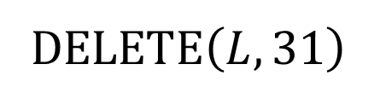



D$ELETE\left(L,31\right)$
$$L_{4}$$
$$−∞$$
$$12$$
$$50$$
$$+∞$$
$$L_{3}$$
$$−∞$$
$$12$$
$$31$$
$$50$$
$$+∞$$
$$L_{2}$$
$$−∞$$
$$12$$
$$20$$
$$31$$
$$40$$
$$50$$
$$60$$
$$+∞$$
$$L_{1}$$
$$−∞$$
$$12$$
$$17$$
$$20$$
$$25$$
$$31$$
$$38$$
$$40$$
$$44$$
$$50$$
$$55$$
$$60$$
$$67$$
$$+∞$$

Slide 7
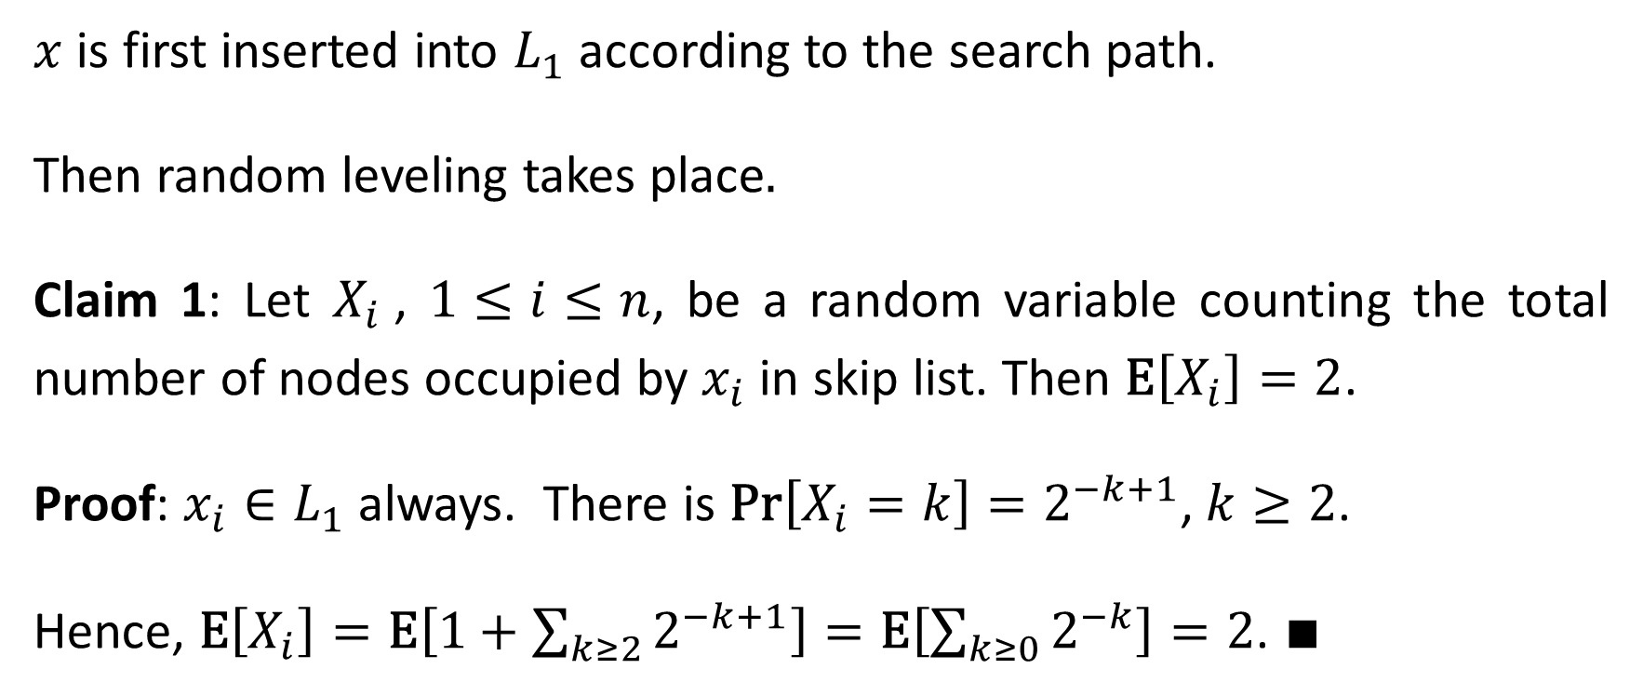
Space Analysis
$x$ is first inserted into $L_{1}$ according to the search path.
Then random leveling takes place.
Claim 1: Let $X_{i}$, $1≤i≤n$, be a random variable counting the total number of nodes occupied by $x_{i}$ in skip list. Then $\text{E}\left[X_{i}\right]=2$.
Proof: $x_{i}∈L_{1}$ always. There is $\text{Pr}\left[X_{i}=k\right]=2^{−k+1}$, $k≥2$.
Hence, $\text{E}\left[X_{i}\right]=\text{E}\left[1+\sum_{k≥2}{2^{−k+1}}\right]=\text{E}\left[\sum_{k≥0}{2^{−k}}\right]=2$. ∎

Slide 8
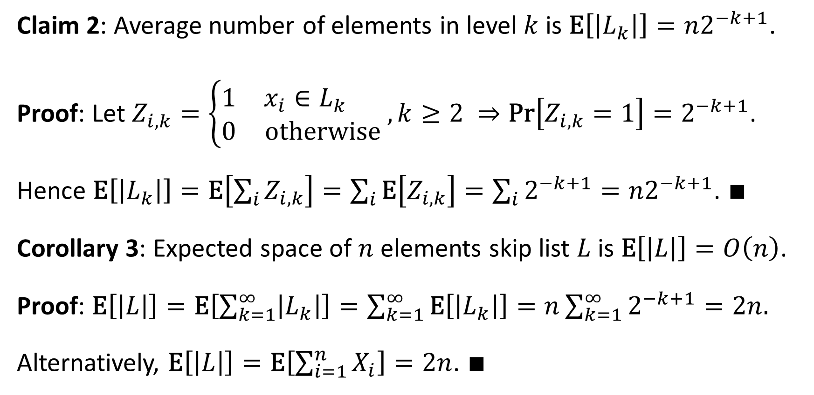
Claim 2: Average number of elements in level $k$ is $\text{E}\left[\left|L_{k}\right|\right]=n2^{−k+1}$.
Proof: Let $Z_{i,k}=\left\{\begin{matrix}1 & x_{i}∈L_{k} \\ 0 & \text{otherwise}\end{matrix}\right., k≥2 ⇒\text{Pr}\left[Z_{i,k}=1\right]=2^{−k+1}$.
Hence $\text{E}\left[\left|L_{k}\right|\right]=\text{E}\left[\sum_{i}{Z_{i,k}}\right]=\sum_{i}{\text{E}\left[Z_{i,k}\right]}=\sum_{i}{2^{−k+1}}=n2^{−k+1}$. ∎
Corollary 3: Expected space of $n$ elements skip list $L$ is $\text{E}\left[\left|L\right|\right]=O\left(n\right)$.
Proof: $\text{E}\left[\left|L\right|\right]=\text{E}\left[\sum_{k=1}^{∞}{\left|L_{k}\right|}\right]=\sum_{k=1}^{∞}{\text{E}\left[\left|L_{k}\right|\right]}=n\sum_{k=1}^{∞}{2^{−k+1}}=2n.$
Alternatively, $\text{E}\left[\left|L\right|\right]=\text{E}\left[\sum_{i=1}^{n}{X_{i}}\right]=2n$. ∎

Slide 9









Run-Time Analysis
Let $P=P_{H}∪P_{V}$ be search path, resulted by $\text{FIND}\left(L,x\right)$, where $P_{H}$ and $P_{V}$ are horizontal and vertical portions of $P$.
Lemma 4: $\text{E}\left[\left|P_{H}\right|\right]=O\left(\log{n}\right)$.
$$−∞$$
50
$$∞$$
$$−∞$$
31
39
50
$$∞$$
$$−∞$$
20
31
39
40
50
$$∞$$
$$−∞$$
17
20
25
31
38
39
40
44
50
55
$$∞$$

Slide 10



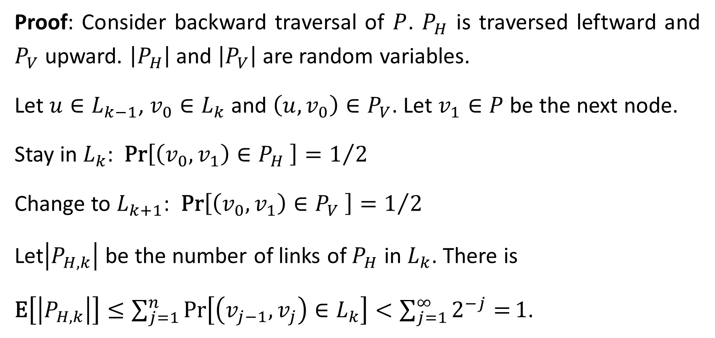




Proof: Consider backward traversal of $P$. $P_{H}$ is traversed leftward and $P_{V}$ upward. $\left|P_{H}\right|$ and $\left|P_{V}\right|$ are random variables.
Let $u∈L_{k−1}$, $v_{0}∈L_{k}$ and $\left(u,v_{0}\right)∈P_{V}$. Let $v_{1}∈P$ be the next node.
Stay in $L_{k}$: $\text{Pr}\left[\left(v_{0},v_{1}\right)∈P_{H} \right]=1/2$
Change to $L_{k+1}$: $\text{Pr}\left[\left(v_{0},v_{1}\right)∈P_{V} \right]=1/2$
Let$\left|P_{H,k}\right|$ be the number of links of $P_{H}$ in $L_{k}$. There is
$\text{E}\left[\left|P_{H,k}\right|\right]≤\sum_{j=1}^{n}{\text{Pr}\left[\left(v_{j−1},v_{j}\right)∈L_{k}\right]}<\sum_{j=1}^{∞}{2^{−j}=}1$.
$$v_{1}$$
$$L_{k+1}$$
$$v_{1}$$
$$v_{0}$$
$$L_{k}$$
$$u$$
$$L_{k−1}$$

Slide 11
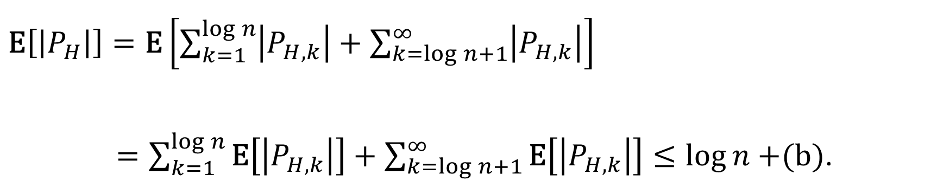
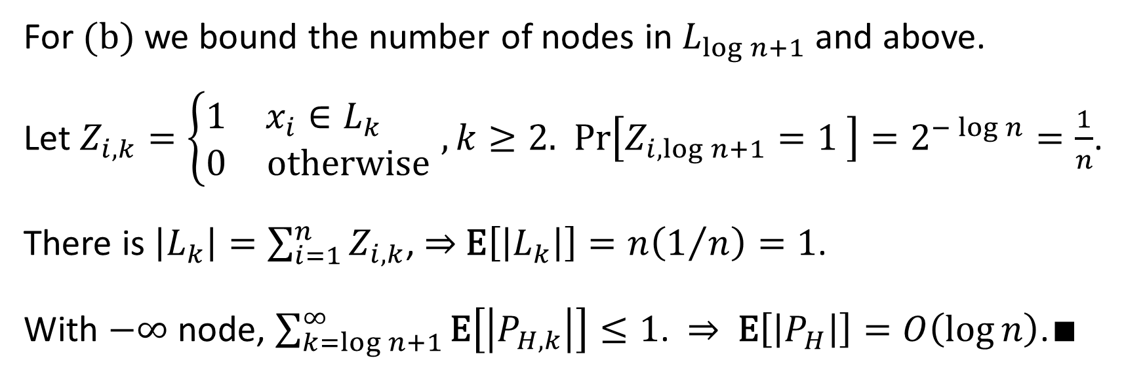
$\text{E}\left[\left|P_{H}\right|\right]=\text{E}\left[\sum_{k=1}^{\log{n}}{\left|P_{H,k}\right|}+\sum_{k=\log{n}+1}^{∞}{\left|P_{H,k}\right|}\right]$
$=\sum_{k=1}^{\log{n}}{\text{E}\left[\left|P_{H,k}\right|\right]}+\sum_{k=\log{n}+1}^{∞}{\text{E}\left[\left|P_{H,k}\right|\right]}≤\log{n}+$(b).
(a)
(b)
For $(\text{b})$ we bound the number of nodes in $L_{\log{n}+1}$ and above.
Let $Z_{i,k}=\left\{\begin{matrix}1 & x_{i}∈L_{k} \\ 0 & \text{otherwise}\end{matrix}\right.$ $, k≥2$. $\text{Pr}\left[Z_{i,\log{n}+1}=1 \right]=2^{−\log{n}}=\frac{1}{n}$.
There is $\left|L_{k}\right|=\sum_{i=1}^{n}{Z_{i,k}}$, ⇒ $\text{E}\left[\left|L_{k}\right|\right]=n\left(1/n\right)=1$.
With $−∞$ node, $\sum_{k=\log{n}+1}^{∞}{\text{E}\left[\left|P_{H,k}\right|\right]}≤1$. ⇒ $\text{E}\left[\left|P_{H}\right|\right]=O\left(\log{n}\right)$.∎

Slide 12
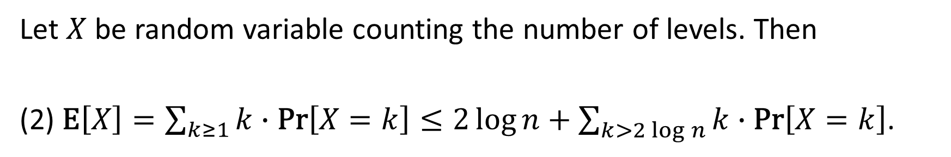
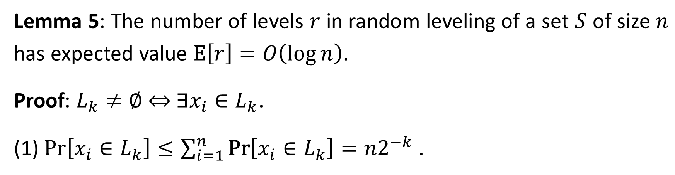
Lemma 5: The number of levels $r$ in random leveling of a set $S$ of size $n$ has expected value $\text{E}\left[r\right]=O\left(\log{n}\right)$.
Proof: $L_{k}≠∅$ ⇔ $∃x_{i}∈L_{k}$.
(1) $\text{Pr}\left[x_{i}∈L_{k}\right]≤\sum_{i=1}^{n}{\text{Pr}\left[x_{i}∈L_{k}\right]}=n2^{−k}$ .
Let $X$ be random variable counting the number of levels. Then
(2) $\text{E}\left[X\right]=\sum_{k≥1}{k∙\text{Pr}\left[X=k\right]}≤2\log{n}+\sum_{k>2\log{n}}{k∙\text{Pr}\left[X=k\right]}$.
(a)
(b)
$(\text{a})$taken for certain $2\log{n}$ levels. Let us bound $(\text{b})$.

Slide 13

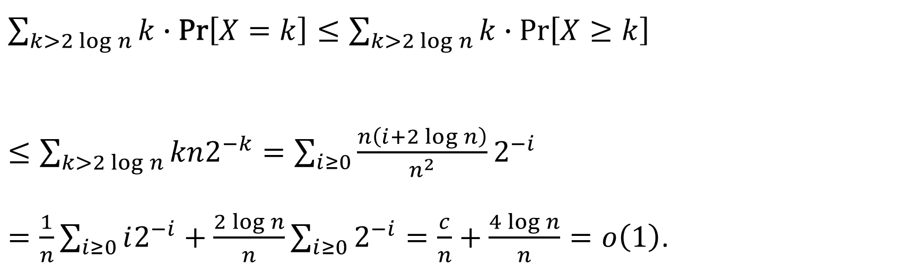
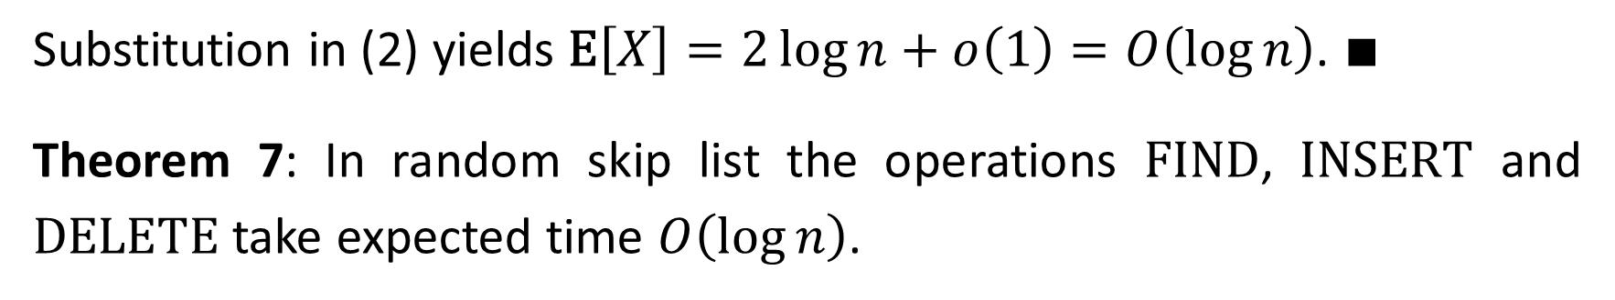

$\sum_{k>2\log{n}}{k∙\text{Pr}\left[X=k\right]}≤\sum_{k>2\log{n}}{k∙\text{Pr}\left[X≥k\right]}$
$≤\sum_{k>2\log{n}}{kn2^{−k}}=\sum_{i≥0}{\frac{n\left(i+2\log{n}\right)}{n^{2}}2^{−i}}$
$=\frac{1}{n}\sum_{i≥0}{i2^{−i}}+\frac{2\log{n}}{n}\sum_{i≥0}{2^{−i}}=\frac{c}{n}+\frac{4\log{n}}{n}=o\left(1\right)$.
$$(1)$$
$$2^{−2\log{n}}=1/{n^{2}}$$
Substitution in (2) yields $\text{E}\left[X\right]=2\log{n}+o\left(1\right)=O\left(\log{n}\right)$. $∎$
Theorem 7: In random skip list the operations $\text{FIND}$, $\text{INSER}\text{T}$ and $\text{DELETE}$ take expected time $O\left(\log{n}\right)$.

